Slide 1
ECON 5305 Data Translation Group 2: McKenzie Maidl, Tuan Anh Nguyen, Samikshya Pandey

Slide 2
GOAL
1. Understand existing time series patterns in vehicle sales in US.
2. Can we predict the demand for vehicle sales in future?

Slide 3
Vehicle Sales Prediction Dataset
Quarterly Total vehicle sales in US in millions
Seasonally Adjusted from 1976 Quarter 1 to 2023 Quarter 1
Source: FRED (https://fred.stlouisfed.org/series/TOTALSA)

Slide 4
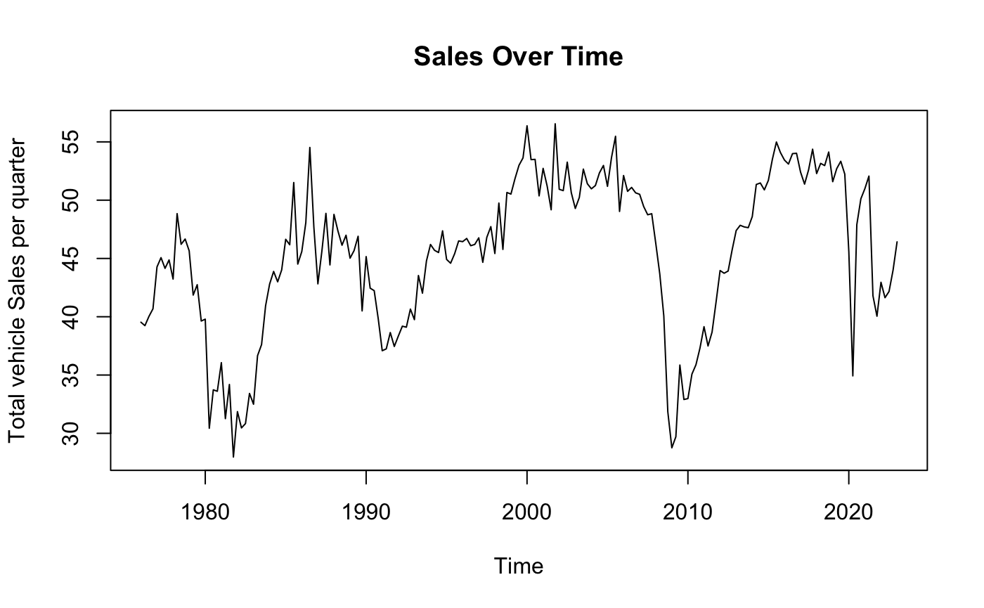
Time Series Original Data
There appears to have some cyclical patterns.

Slide 5
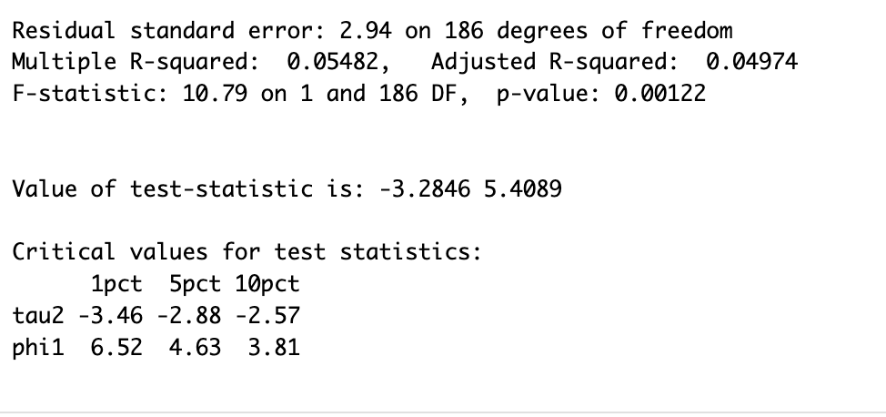
Testing for Stationarity
Augmented Dickey-Fuller Test
Test statistic value is -3.28 and the critical value is greater than 1pct critical value.
Do not reject the null hypothesis.
Shows our data is not stationary

Slide 6
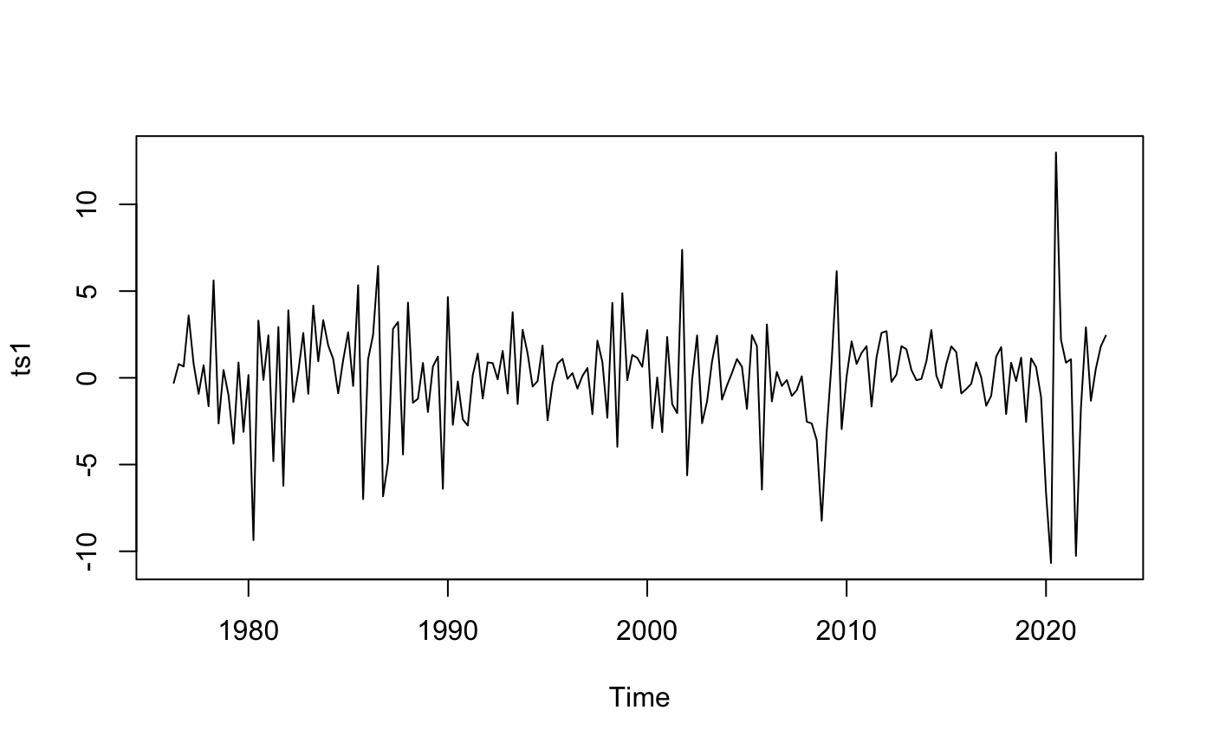
Make Data Stationary
The log difference of the time series is stationary
The new Augmented Dickey-Fuller Test results in a test statistic of -17.20. We can reject the null hypothesis.
Subsequent analysis will use this time series.
Notes:
Diff with “drift”

Slide 7
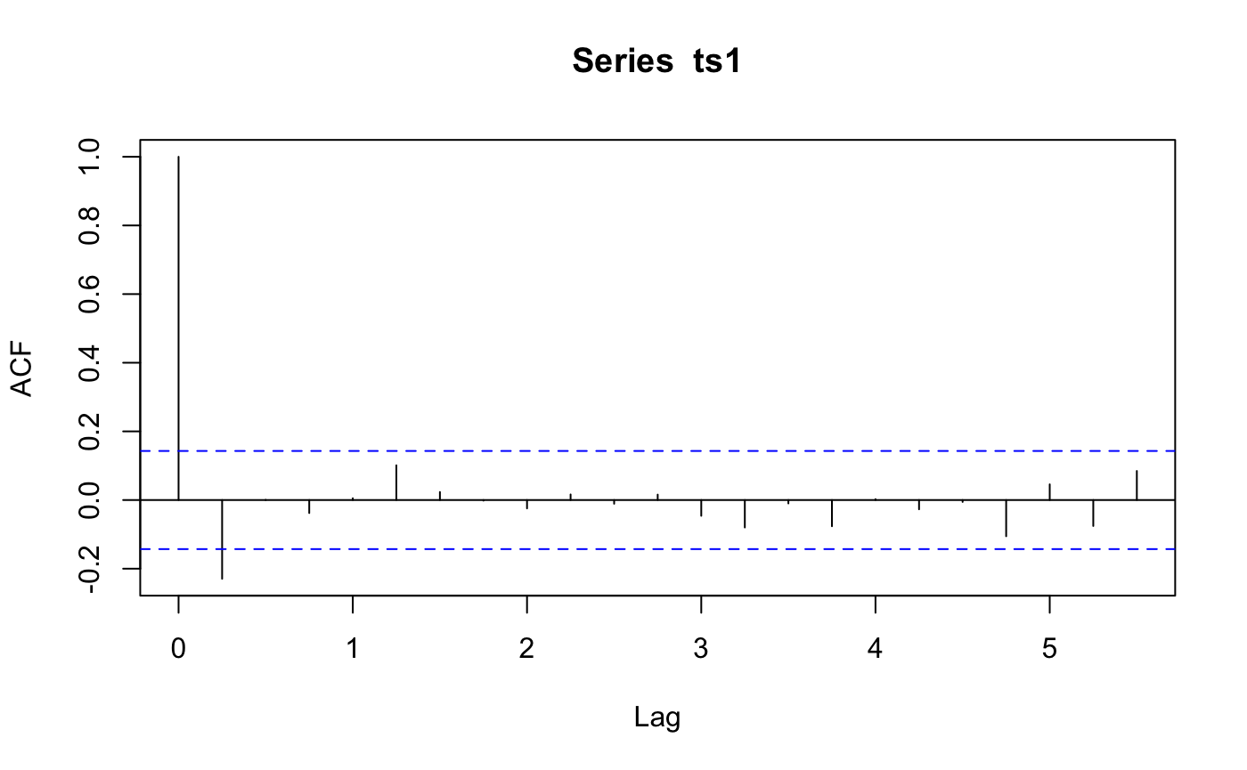
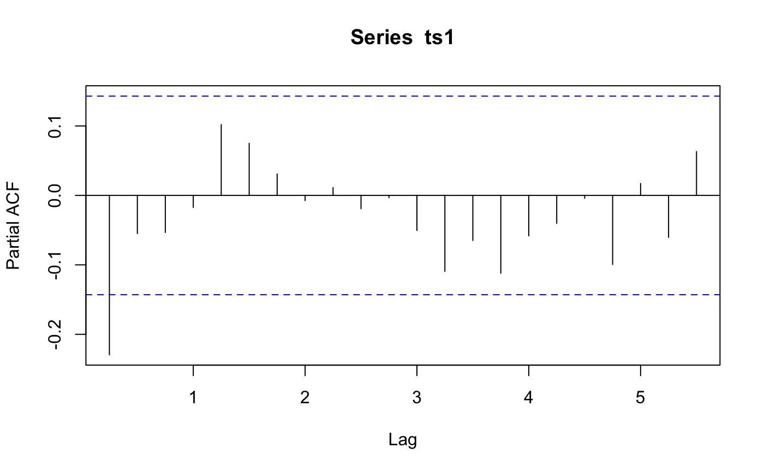
ACF and PACF
PACF seems to have some cyclical patterns but all within
significant lines
Significant spike till lag 1
Notes:
The ACF and PACF indicate that an MA(1) model might be appropriate.

Slide 8
Top 3 Models:
Model | R^2 | AIC | BIC | Mean residual
AR(1) | 0.05283403 | 943.4648 | 953.1741 | -3.659734e-04
MA(1) | 0.05695238 | 942.6554 | 952.3647 | -7.351305e-06
ARMA(3,3) | 0.12836404 | 942.5077 | 968.3993 | -7.619365e-03
We chose AR(1) and MA(1) because both models had the best AIC and BIC score. We chose ARMA (3,3) because it had significantly high R^2 value compared to all other combinations.
The mean residuals is close to 0 for all models which shows that the residuals in our models are white noise

Slide 9

Model in Regression format:
MA(6)
Y(t) = 0.3685 -0.1627​${\text{ϵ}}_{\text{t}\text{−1}\text{​}}$+ 0.1893​${\text{ϵ}}_{\text{t}\text{−2​}}$ -0.4914 ${\text{ϵ}}_{\text{t}\text{−3}}$ -0.0392​​${\text{ϵ}}_{\text{t}\text{−4}}$ + 0.0228${\text{ϵ}}_{\text{t}\text{−5​}}$ -0.5188 ${\text{ϵ}}_{\text{t}\text{−6​}}$+ 0.3685
Notes:
-0.1627 0.1893 -0.4914 -0.0392 0.0228 -0.5188 0.3685 ma1 ma2 ma3 ma4 ma5 ma6 intercept

Slide 10
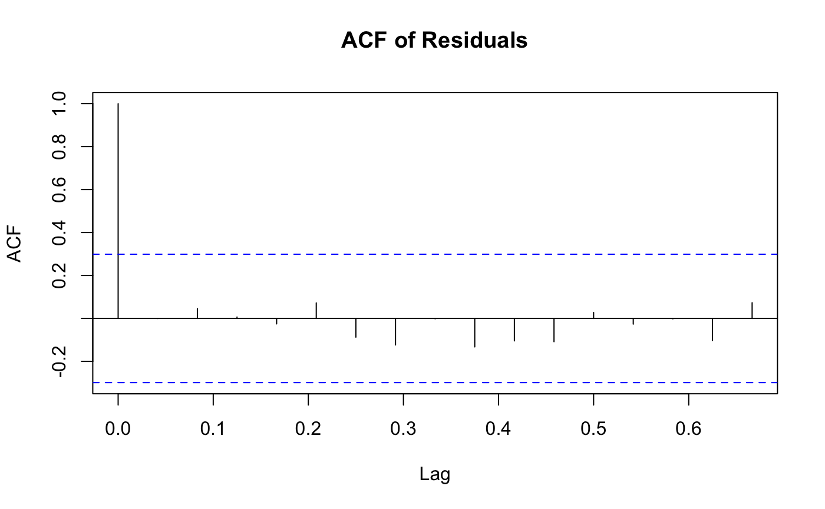
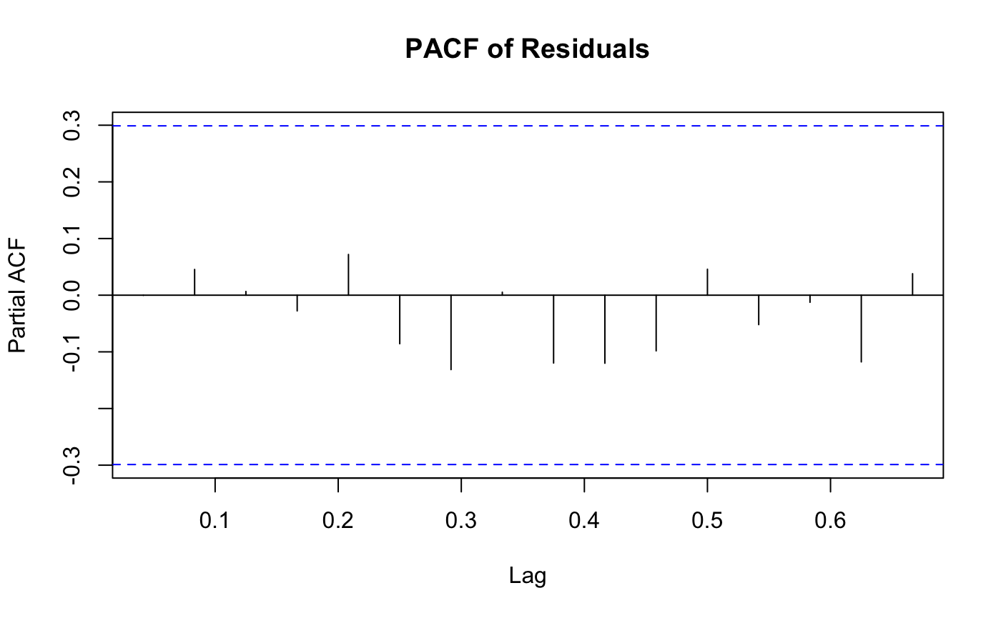
Choosing MA(6):
ACF and PACF of residuals:

Slide 11
White Noise confirmations through Q-Test of the residuals:
Ljung-Box
MODEL | P-value | White noise confirmation
AR(1) | 0.9981 | Yes
MA(1) | 0.955 | Yes
ARMA(3,3) | 0.9136 | Yes

Slide 12
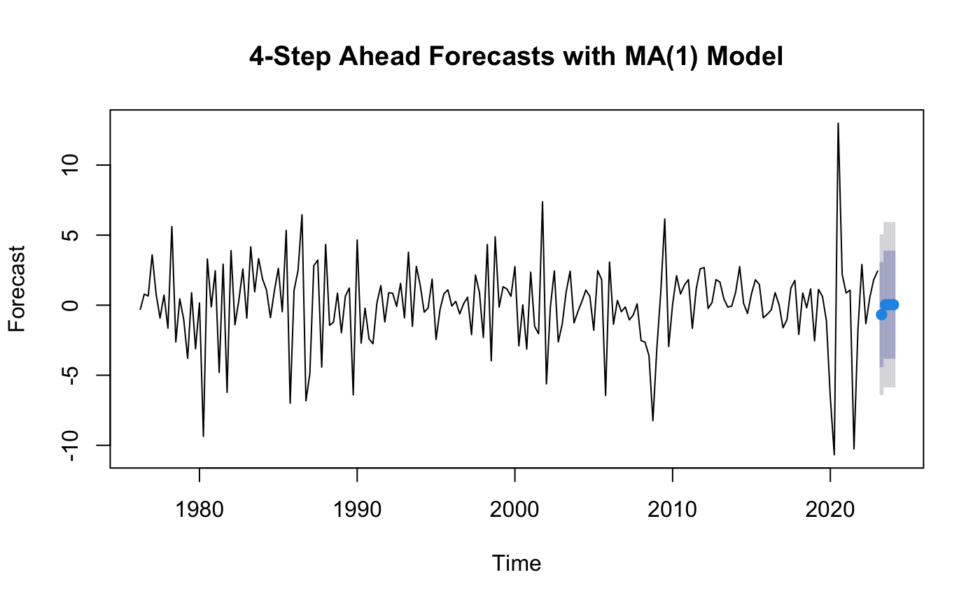
4 step ahead forecast:
MODEL: MA(1)
Notes:
The ACF and PACF indicate that an MA(1) model might be appropriate.

Slide 13

4 step ahead forecast:
MODEL: AR(1)
Notes:
The ACF and PACF indicate that an MA(1) model might be appropriate.

Slide 14

4 step ahead forecast:
Notes:
The ACF and PACF indicate that an MA(1) model might be appropriate.

Slide 15
FINETUNING MODELS
Finetuning Models By Doing Loss Comparisons, different fixed, rolling and recursive methods to create the best forecasting models

Slide 16
Loss Comparison
1 Step Ahead
Model | Scheme | MPE | IE | MSE | MAE | MAPE
Naïve | Fixed | 0.1206 | NA | 26.7800 | 3.9700 | 0.2388
Simple Average | Fixed | 0.1091 | NA | 23.6300 | 3.1600 | 0.1033
ARMA(3,3) | Fixed | -0.1933 | -2.5508 | 32.0649 | 4.0842 | 0.1859
ARMA(3,3) | Recursive | -0.4301 | -1.6352 | 27.3286 | 3.5896 | 0.1350
ARMA(3,3) | Rolling | -0.1852 | -1.8625 | 28.0679 | 3.7473 | 0.1358
MA(1) | Fixed | -0.5188 | -0.3659 | 23.4502 | 3.2570 | 0.1076
MA(1) | Recursive | -0.4287 | -0.7748 | 24.5204 | 3.3378 | 0.1108
MA(1) | Rolling | -0.3705 | -1.2314 | 25.5516 | 3.3770 | 0.1085
AR(1) | Fixed | -0.4814 | -0.8891 | 24.7411 | 3.3132 | 0.1019
AR(1) | Recursive | -0.3958 | -1.1591 | 25.5312 | 3.3641 | 0.1035
AR(1) | Rolling | -0.3191 | -1.4461 | 26.1227 | 3.3778 | 0.1018

Slide 17
Loss Comparison
2 Steps Ahead
Model | Scheme | MPE | IE | MSE | MAE | MAPE
Naïve | Fixed | 0.1091 | NA | 27.7300 | 4.0200 | 0.2334
Simple Average | Fixed | 0.1003 | NA | 24.8000 | 3.2800 | 0.1001
ARMA(3,3) | Fixed | -0.1120 | -2.5705 | 31.205 | 3.9093 | 0.1600
ARMA(3,3) | Recursive | -0.2662 | -2.1672 | 28.4399 | 3.6589 | 0.1381
ARMA(3,3) | Rolling | -0.2229 | -1.4143 | 27.1370 | 3.6996 | 0.1333
AR(1) | Fixed | -0.3098 | -1.5607 | 26.1955 | 3.3358 | 0.0937
AR(1) | Recursive | -0.3135 | -1.5380 | 26.0621 | 3.3281 | 0.0949
AR(1) | Rolling | -0.3397 | -1.3478 | 25.7483 | 3.2988 | 0.0941

Slide 18
Combined Forecasts
1 Step Ahead
Models: ARMA(3,3), MA(1), and AR(1)
Scheme: Fixed for each
Combination Method | MSE
Equal-weighted Forecast | 26.01
MSE-inversely-weighted Forecast | 23.61
OLS-weighted Forecast | 17.85

Slide 19
Combined Forecasts
2 Steps Ahead
Models: ARMA(3,3), MA(1), and AR(1)
Scheme: Fixed for each
Combination Method | MSE
Equal-weighted Forecast | 26.60
MSE-inversely-weighted Forecast | 24.97
OLS-weighted Forecast | 19.40

Slide 20
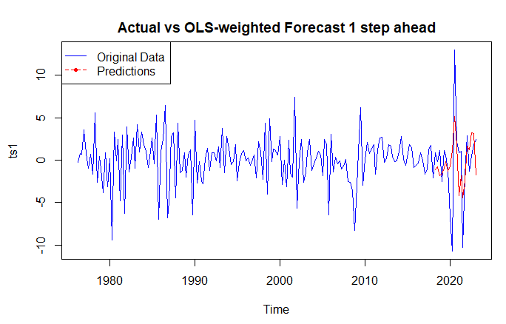
Combined Forecast
1 Step Ahead: OLS weighted ARMA(3,3), MA(1) and AR(1)

Slide 21
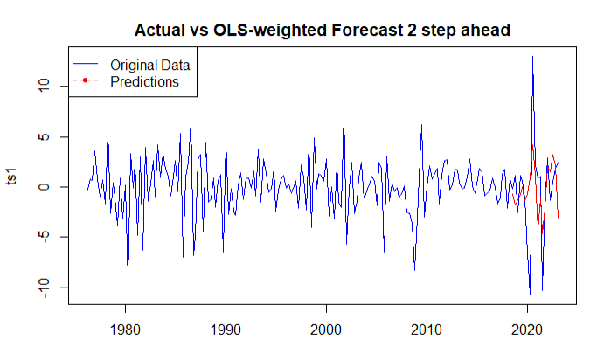
Combined Forecast
2 Steps Ahead

